Slide 1
Measure the length of the screen diagonal in cm
Notes:
ScreenSizeInstruction.png

Slide 2
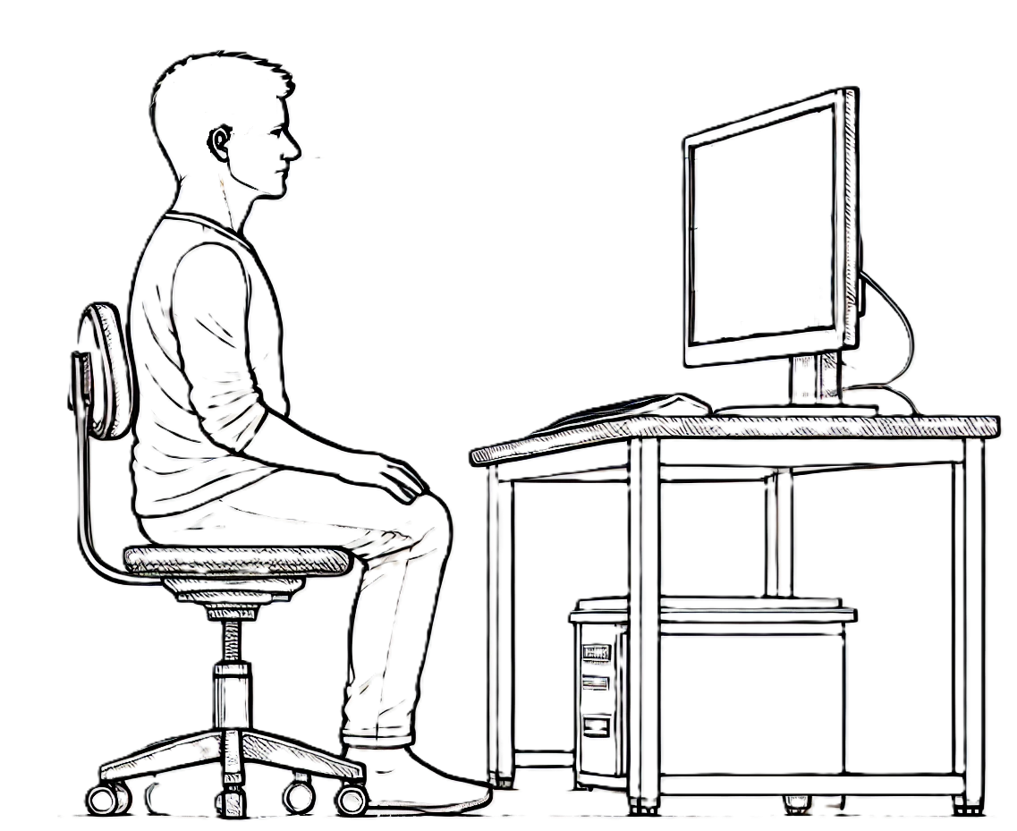
Distance in cm
Measure the distance from the eyes of the subject to the screen
Notes:
ScreenPositionInstruction.png

Slide 3
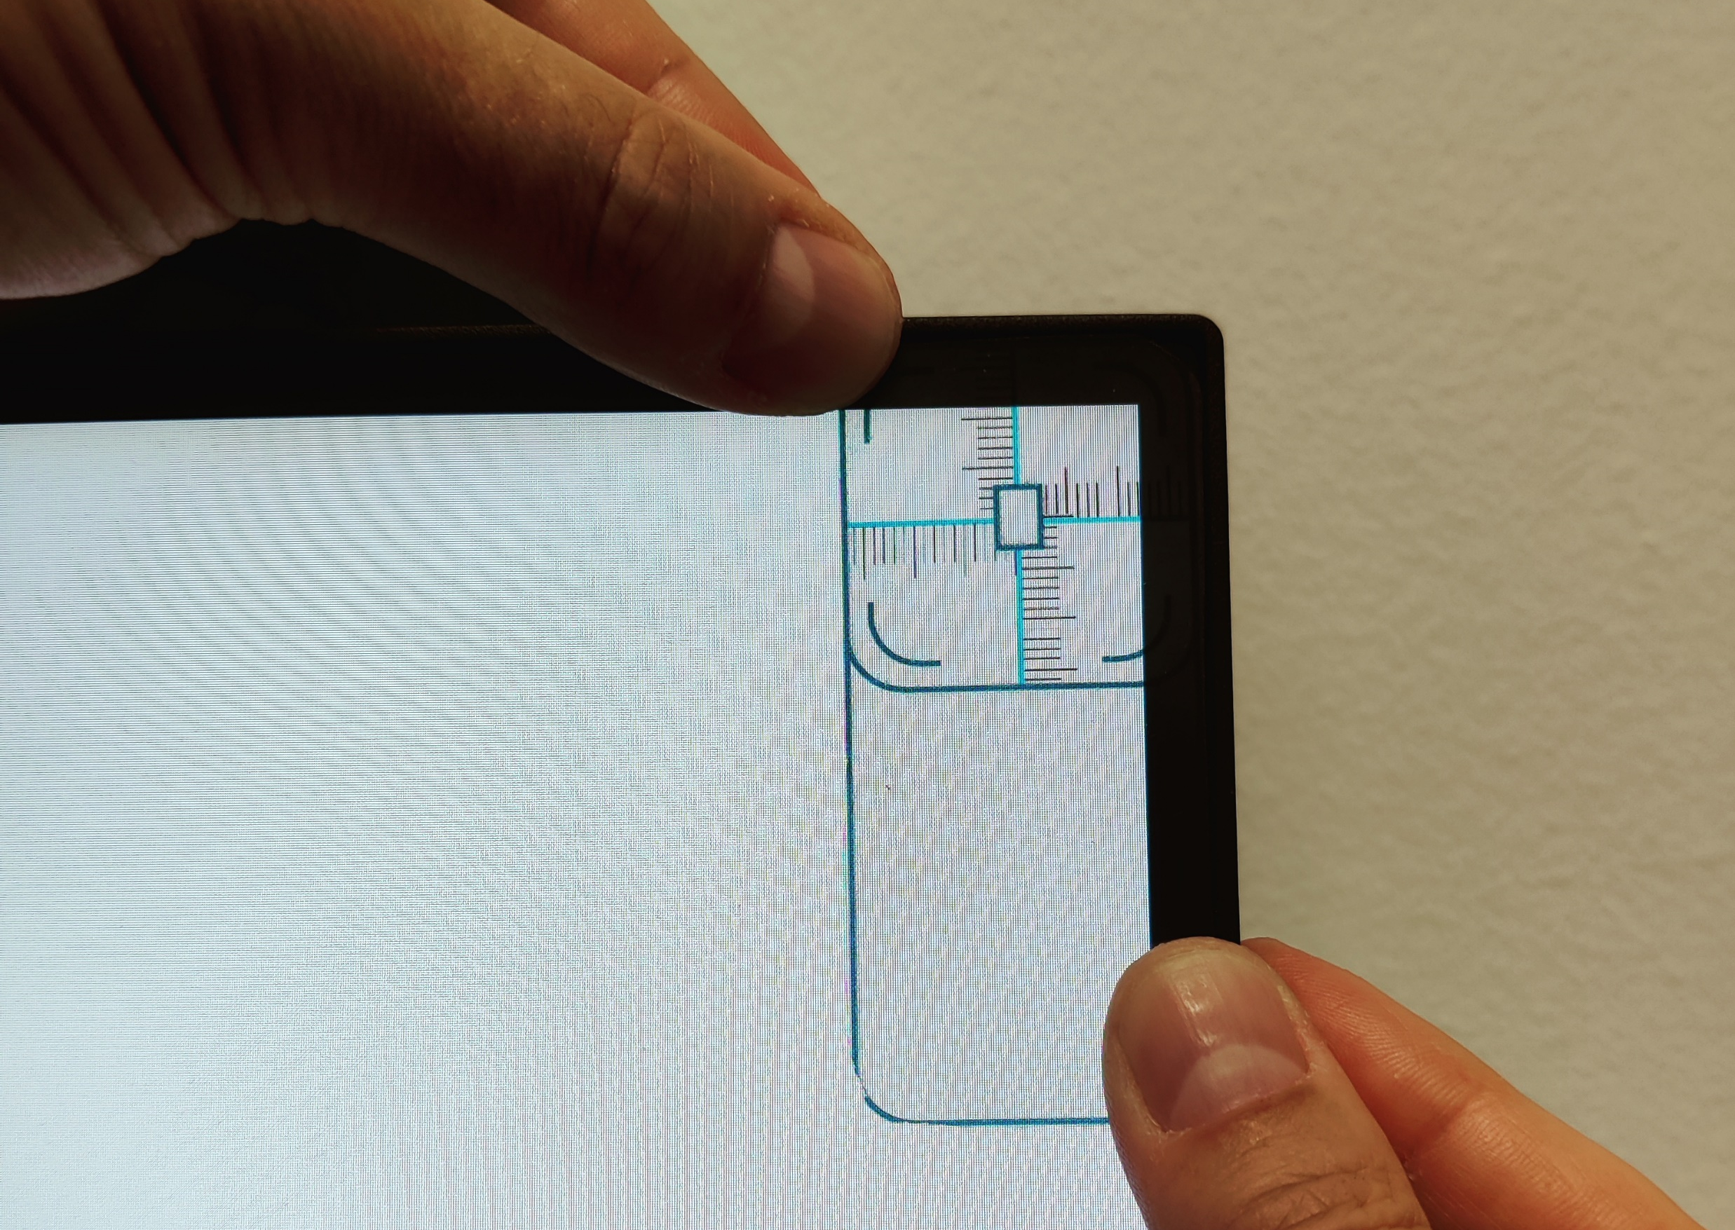
Measure the required position of the fiducial with the VTG Calibrator
Procedure:
Place the VTG Calibrator in the screen corner where the fiducials are to be generated.
Read of the vertical and horizontal distances from the centre of the fiducial edge of display area.
Please see the LabBench VTG manual if further information is required on the calibration procedure.
Notes:
PositionInstruction.png

Slide 4
Notes:
Blank.png

Slide 5
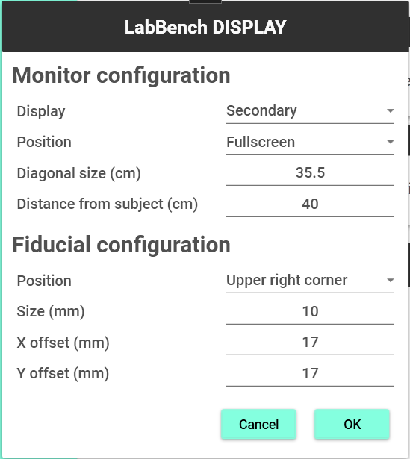
Update the LabBench DISPLAY configuration in the LabBench Designer program
LabBench Designer
Please note this required that you close LabBench Runner to change the configuration in LabBench Designer. When you close LabBench Designer the calibration values will be written to the PDF file by the Post Session Action named Create Calibration Record. Once you updated the LabBench DISPLAY configuration restart this protocol to validate the calibration of the screen and fiducial.
1
2
3
4
Notes:
UpdateInstruction.png

Slide 6
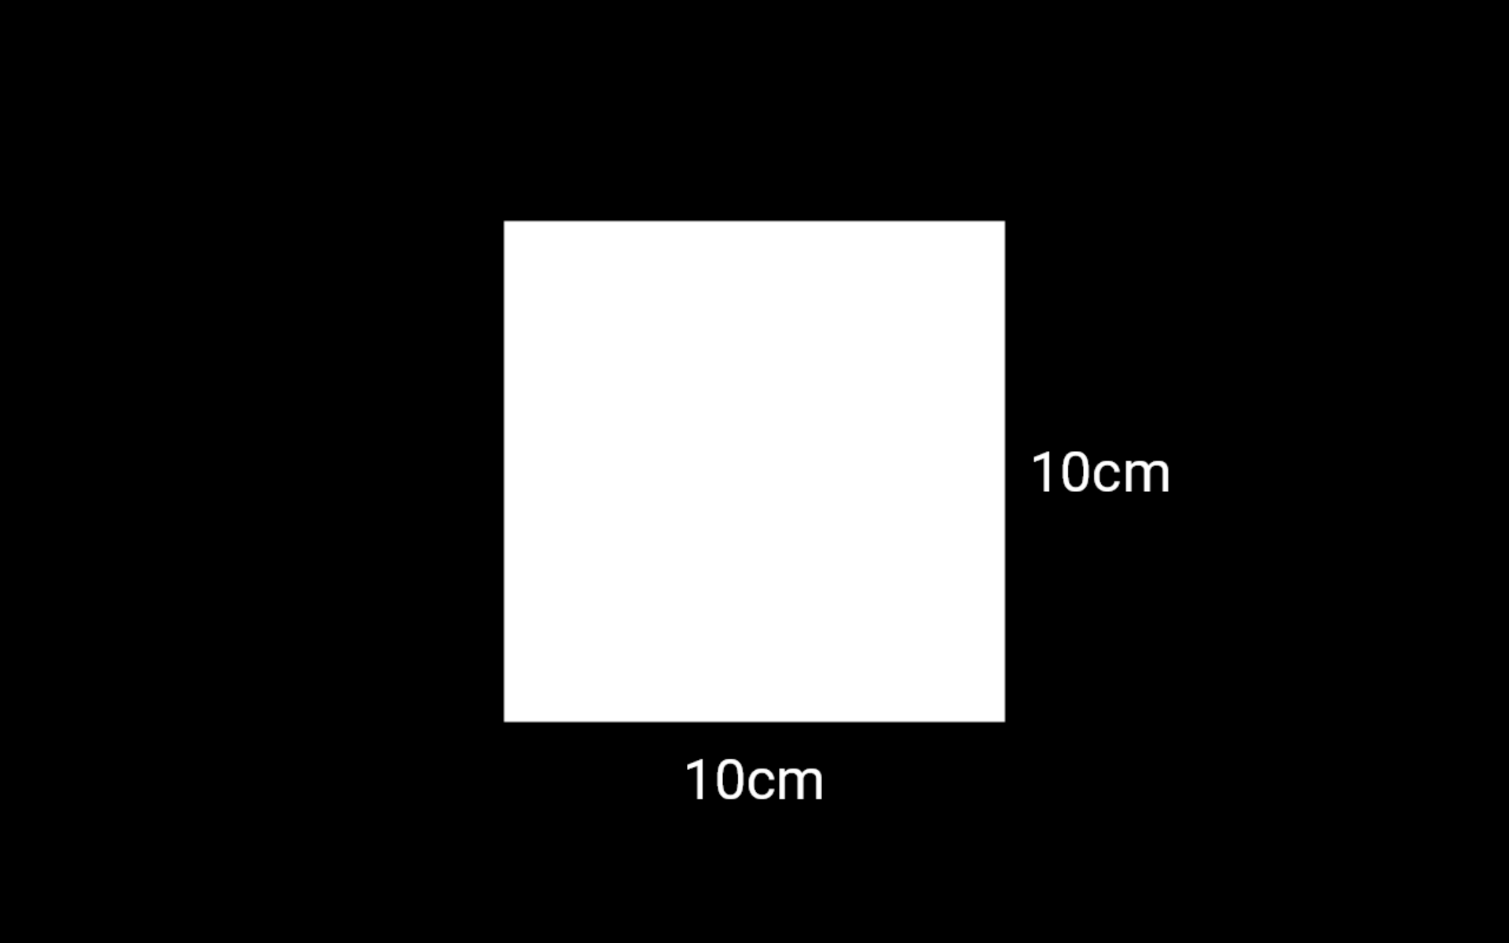
Verify the screen size calibration by checking that a square drawn to be 10 x 10 cm in size is of the correct size.
Notes:
VerifySizeInstruction.png

Slide 7
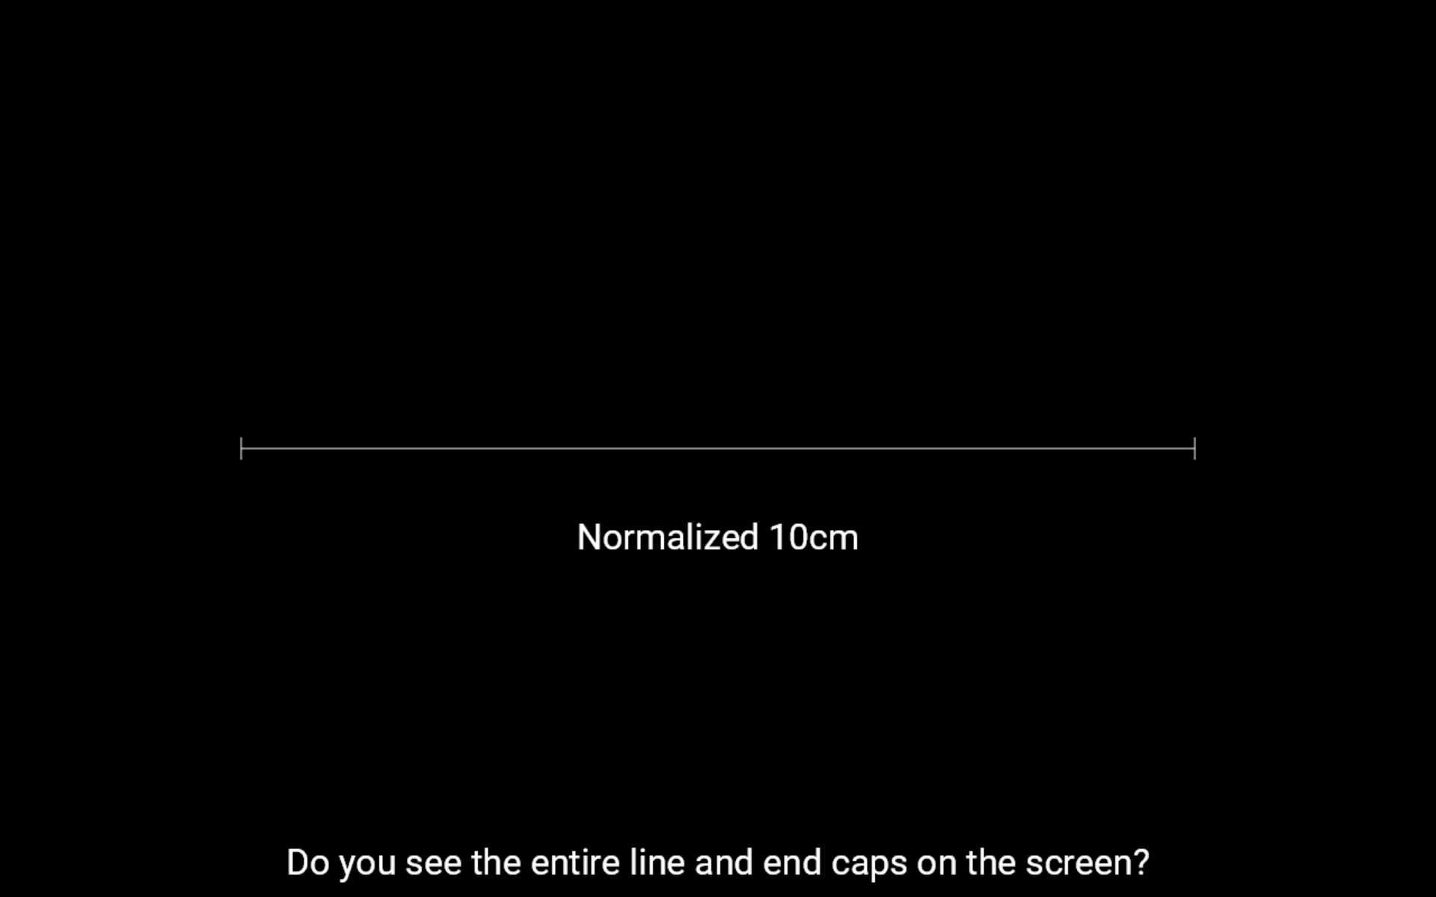
Verify that normalization of visual analog rating scales with a length of 10cm can be displayed on the screen.
Notes:
VerifyAngleInstruction.png

Slide 8
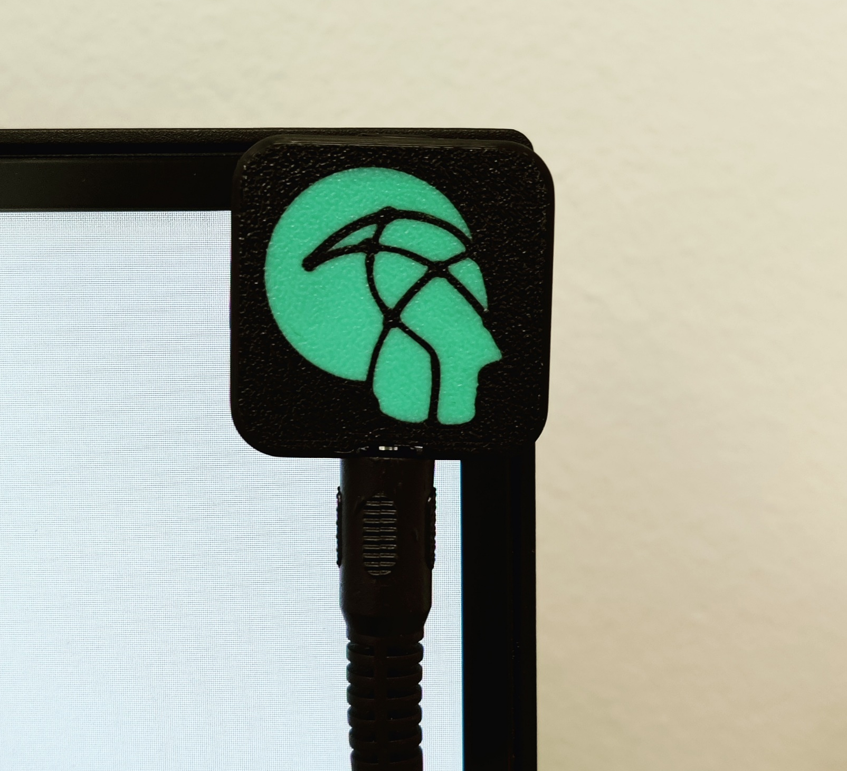
Start the test to generate a fiducial and use the LabBench VTG device to confirm that the fiducial is in the correct position
Notes:
VerifyFiducialInstruction.png

Slide 9

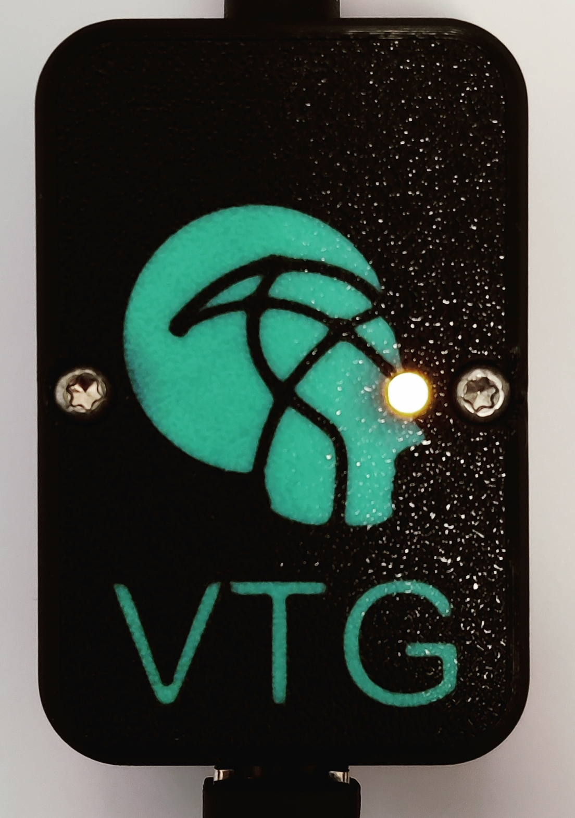


Check with the VTG calibrator that the fiducial is in the correct position
GREEN
YELLOW
FAILED
PASSED
If the diode on the LabBench VTG is GREEN it means the fiducial failed to generate a trigger.
If the diode on the LabBench VTG is YELLOW it means the fiducial generated a trigger.
Notes:
FiducialCheck.png

Slide 10
Mount the LabBench VTG device on the screen and start this test.
This test will generate a series of visual stimuli with fiducials and will verify that triggers are correctly generated by the LabBench VTG.
Each stimuli will consist of displaying a number. Each time you see a number press any button on the LabBench PAD.
Notes:
TestInstruction.png

Slide 11
1
Notes:
S1.png

Slide 12
2
Notes:
S2.png

Slide 13
3
Notes:
S3.png

Slide 14
4
Notes:
S4.png

